Slide 1
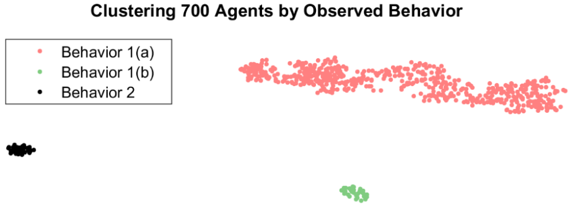
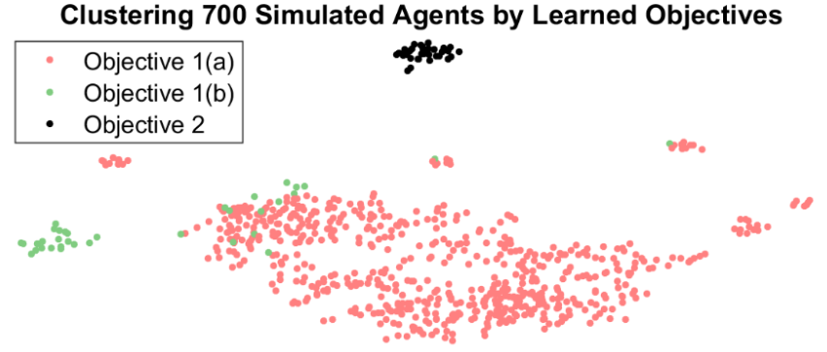
Assistive Agents for Self-Represented Litigants
Mark Rucker and Matthew S. Gerber Daniel Becker
University of Virginia Thomson Reuters
NEED & INDUSTRIAL RELEVANCE
PROJECT GOALS
OBJECTIVES
In America today fewer than one in five low-income individuals have access to the legal help they need¹
To meet this need it is estimated that federal spending on legal aid needs to increase from $300M to $1.6B¹
Meet legal needs without increasing federal spending
Give truly helpful and personalized assistance to SRLs
Connect SRLs with attorneys and courts when needed
Conduct seminal research into digital assistants
Demonstrate usefulness of RL to knowledge services
Extend current research to identify an SRL’s objectives and needs (Rewards) based on their behaviors (Policy)
Assistive Agent
Courts
Attorneys
Self Represented Litigants
Statistical analysis of simulated behavior. There are three clear groups even though two groups are known to share objectives
Analysis of objectives learned from simulated behavior. Here we see group 1 (a) and (b) begin to look similar despite different behaviors above
Documenting The Justice Gap In America 2009
Legal Services Corporation Funding (www.lsc.gov/lsc-funding)
APPROACH (RESEARCH METHODS)
DELIVERABLES/OUTCOMES
IMPACT
Hypothesis: Capturing an SRL’s objectives is key to personalized process insights, improved attorney-litigant matching and smart recommendations.
Data: Currently using synthetic data from an ABM. We are in the process of acquiring naturalized SRL data.
Analysis: With the data an MDP is designed to capture system dynamics. Using the MDP, agents can be viewed as Reinforcement Learners with recoverable objectives.
Current Results: Using IRL we have extracted artificial agent objectives and demonstrated these objectives are sufficient to fully explain observed agent behavior
Planned Results: State features most important to explaining given SRL objectives will be discovered and experiments will be designed to show this importance
A framework for determining useful SRL rewards
An MDP model which fully captures the SRL process
Source code used to determine SRL objectives
Submission of work to the 2018 TIG Conference
[Submission of paper to recommended conference]
Increased access to legal services for SRL’s
Measurable increase in legal outcomes for SRL’s
Advancements in using MDP’s to model human systems
Demonstrated use of IRL to capture human objectives
New business for attorneys through litigant matching
Decreased pressure on court help and service desks

Slide 2
Understanding behavior at an individual level rather than an aggregate can lead to better digital assistance (prescriptive) as well as insight into why some legal cases have positive outcomes and some don’t (descriptive).
What we did…
We took an explicitly individualistic approach to learning human behavior. This allowed us to uniquely define each person’s motivations and expected behavior.
Despite the individual nature of this approach we were also able to identify global clusters from individual behavior and accurately recreate outcomes from aggregate group of individual actors.

